Slide 1
Pilot Training
Overview

Slide 2
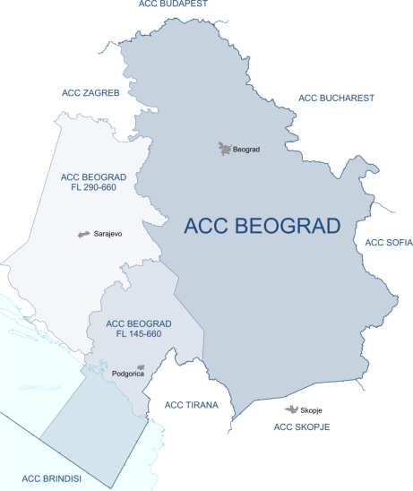
About us
Serbia and Montenegro Air Traffic Services (SMATSA), LLC is the provider of air navigation services in the airspace of the Republic of Serbia, State of Montenegro, 55% of the upper airspace of Bosnia and Herzegovina and a part of the Adriatic Sea.
SMATSA offers the following services:
  Air Traffic Management
  Meteorological Aviation Information,
  Aviation Information Publications (AIPs),
  Pilot and Air Traffic Control Officer Training
  Flight Inspection Services
  Consulting Services

Slide 3
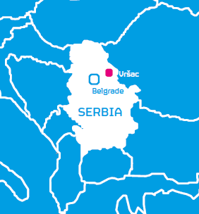
About us
SMATSA Aviation Academy (SAA) is located in Vršac, Serbia – 80km northeast of Belgrade and it specializes in training professional and private pilots
SAA has over 40 employees,
composed of experienced
lecturers and flight
instructors, maintenance
mechanics, management
and administrative staff.

Slide 4
About us
Certified by the Serbian Civil Aviation Directorate (CAD) in accordance to JAR-FCL
Currently undergoing transition to the new EASA ATO regulations
Certified by the Algerian Civil Aviation Directorate (CAD)
ISO 9001:2008 compliant

Slide 5
What sets SAA apart?
Reputation
    We have trained more than 2100 pilots since 1954 that have flown with over 200 different airlines
Capability
    We have our own airport with an air traffic control tower, 1700 square kilometers of dedicated airspace and an updated fleet of 20 airplanes (Cessna 172S, Cessna 172N and Cessna 310)
Value
    We prepare students to become the best pilots they can be at a very competitive price

Slide 6
Reputation

Slide 7
History
First flight in Vršac took place in 1912
Flight training in Vršac dates back to 1925
Vršac became one of Yugoslavia’s Federal Aviation Training Centers in 1954
Training center merged with JAT in 1972, specializing in training commercial airline pilots
Serbia and Montenegro Air Traffic Services (SMATSA) acquired the Vršac training center in 2010

Slide 8








Flight Training Experience
Over 2100 professional pilots trained since 1954
Students from Europe, Africa and Asia
We have partnered with the following airlines in the past:

Slide 9
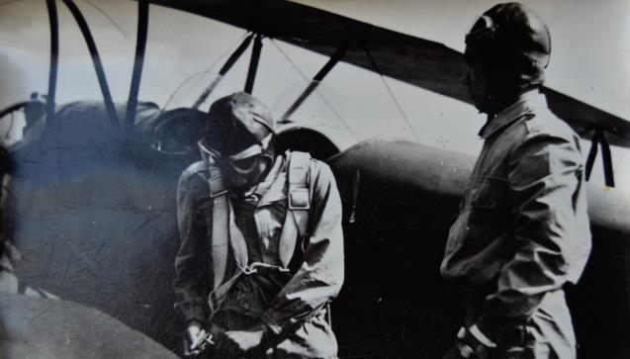
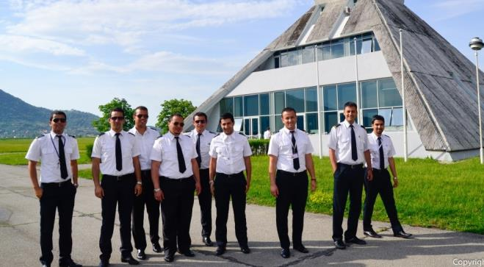
Flight Training Experience
1955.
Tunisia
Jordan
Guinea
Palestine
Syria
Germany
Macedonia
Somalia
Yemen
India
Mauritania
Iraq
Holland
Montenegro
Student from Burma prepares for first solo flight
2013.
Indonesia
Burma
Kenya
Malta
Mali
Greece
Romania
Turkey
Egypt
Sudan
Algeria
Libya
Angola
Bulgaria
Students from Algeria preparing for a flight day

Slide 10
Safety
Safety is our number one priority
Integrated into the company level safety procedures and regulations
  Comply with all Serbian CAD safety regulations
  Culture of open and transparent dialog
  Internal procedures document reporting, review and corrective measure implementation
SMATSA is ranked #2 in safety in Europe

Slide 11
Capability

Slide 12
Campus
Located 4km from downtown Vršac
Spread over 350 hectares of land
Integrated campus
  Training center
  Flight center
  Airport with supporting facilities
  Aircraft maintenance hangar
  ATC tower
  Hotel (under renovation – project planning phase)

Slide 13
Capacity and Utilization
Academy facilities can support up to 150 students per year
Achieved 1852 flight hours in July 2013 which is a school record
2013 in numbers: Five year flight log:

Slide 14
Flight Training Programs
Professional Pilot Licenses | Duration
ATP (A) - integrated | 18 – 24 months
CPL (A) /IR - integrated | 12 – 16 months
CPL (A) - modular | 4 – 6 months
ATP (A) - Modular for PPL holder | 7 – 8 months
ATP (A) – Modular for CPL IR holder | 4 – 5 months
MCC (A) | 3 – 4 weeks
Private Pilot License
PPL (A) | 2– 3 months
Ratings | Duration
FI (A) – Flight instructor | 3 – 4 months
IR (A)/SE - Modular | 4 – 6 months
IR (A)/ME - Modular | 4 – 6 months
Class Rating – MEP (land) | 3 – 4 weeks
Class rating – SEP (land) | 1 – 2 weeks
NQ - Night Qualification | 1 – 2 weeks
English Classes | Duration
English for Aviation | 1 – 6 months

Slide 15
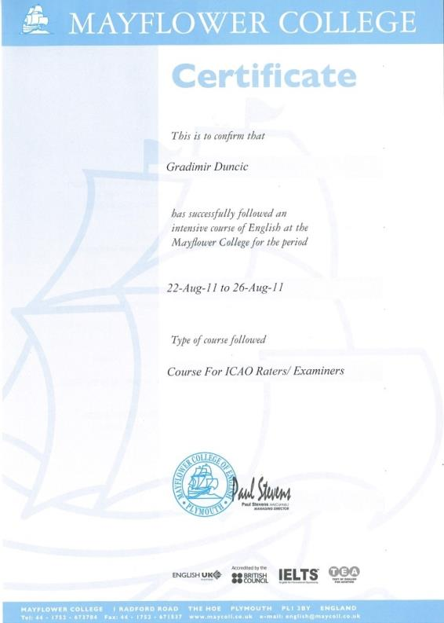
Aviation English Training Program
We have certified examiners for ICAO language proficiency
Our training programs are specially tailored to prepare students to meet this requirement by passing the Test of English for Aviation (TEA) exam

Slide 16
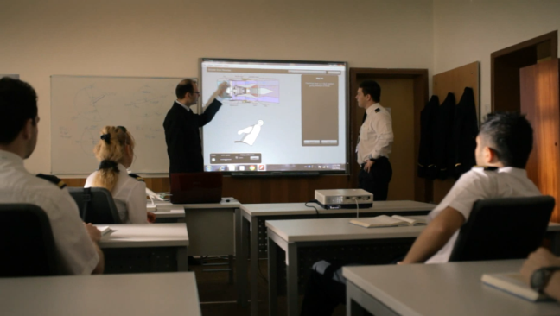
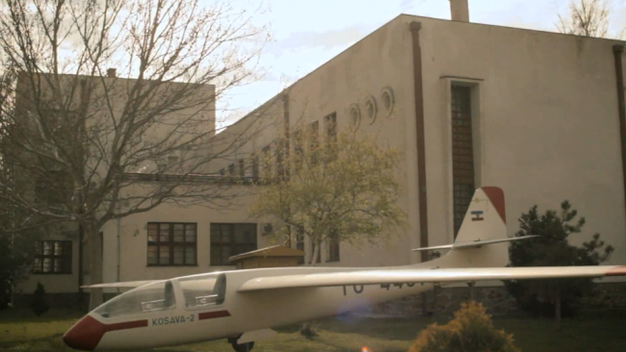
Training and Flight Centers
Furnished with modern equipment to optimize the learning process
Five classrooms and one conference hall
Ten pre- and post-flight briefing rooms

Slide 17
Instructors
SAA flight instructors have a Serbian CAD Instructor Rating and extensive experience in pilot training
Low flight instructor turn over with most experienced flight instructors having more than 7500 flight hours and over 23 years with the Academy
Ground theory instructors are specially employed university degree experts with a wide range of experience in aviation.
All staff is subjected to induction training, regular checks and retraining, where necessary

Slide 18
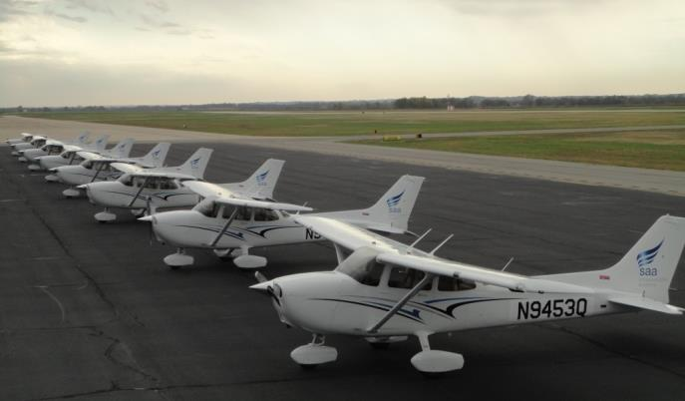
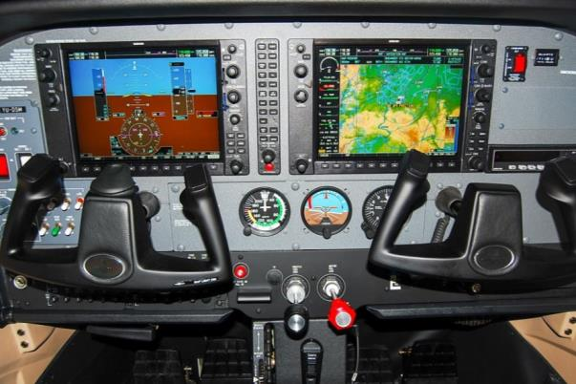
Fleet
Eight brand new Cessna 172S airplanes equipped with Garmin 1000
Ten Cessna 172N airplanes
Two twin-engine Cessna 310T airplanes equipped with Garmin GNS 430

Slide 19
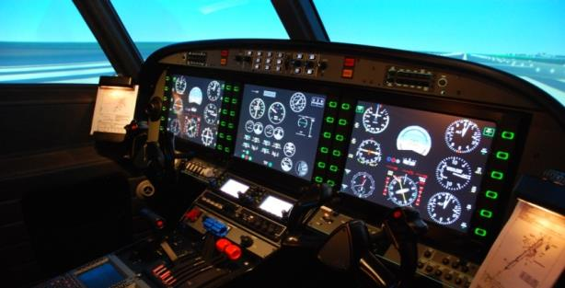
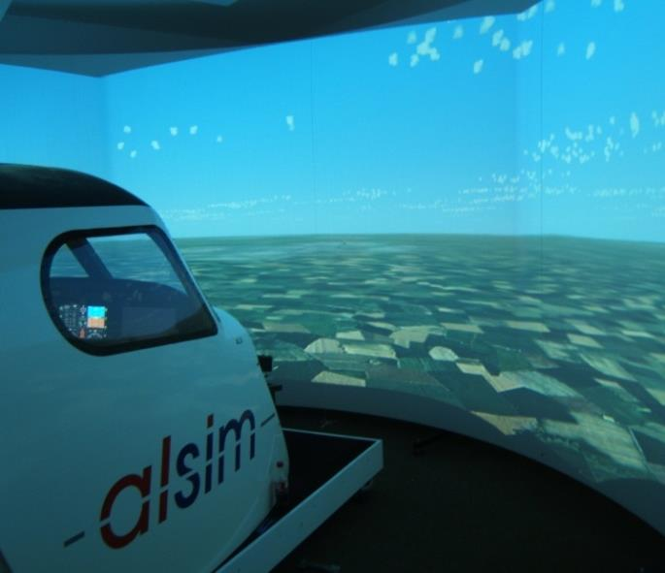
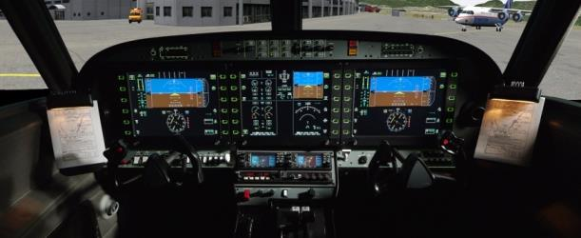
Simulator
Alsim ALX FNPT II simulator
Fully integrated into the training programs

Slide 20
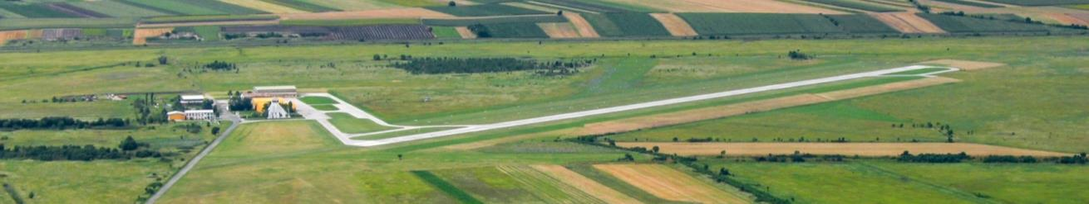
Airport
Category II, owned by SMATSA
Soon to become an official border crossing
Three runways
  01R/19L: Concrete (1000m x 25m)
  01L/19R: Grass (900m x 45m)
  161/341: Grass (600m x 40m)
Lighting equipment for nighttime operations
85m above sea level

Slide 21
Airport
1,700 square kilometers of airspace dedicated to pilot training
ATC tower with air traffic controllers
Navigation aids:
NDB
VOR
Acquisition under way
Installation project in work
Installed and operational
VDF
DME
Acquisition under way
Installation project in work
Installed and operational
ILS
Acquired
Installation project in work

Slide 22
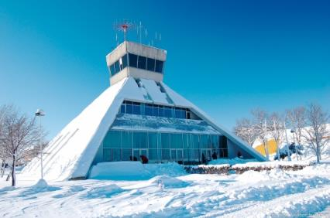
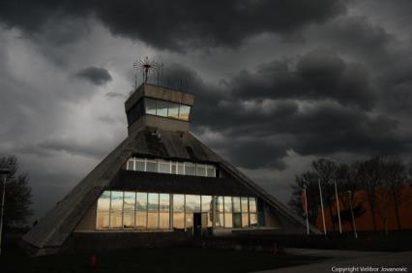
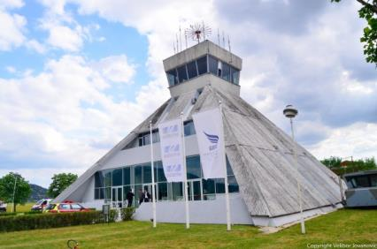
Meteorological Conditions
All four weather seasons (average temp: -0.1°C in January, 20.9°C in June)
Moderate winds accompanied by moderate turbulence up to FL050
Cloud formations with visibility <400m
Snow, rain, mist and fog
24/7 meteo service located in the ATC tower

Slide 23
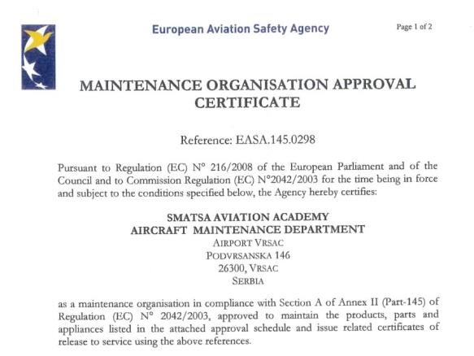
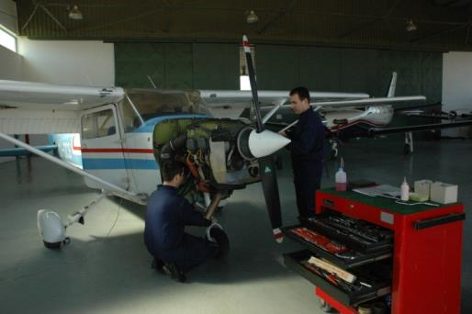
Maintenance
SAA maintains its own airplanes, which ensures the highest levels of airplane safety and availability
EASA Part 145 approved maintenance organization
Approved for maintenance of single engine Cessna and Piper airplanes
Approved for regular maintenance of Lycoming and Continental piston engines

Slide 24
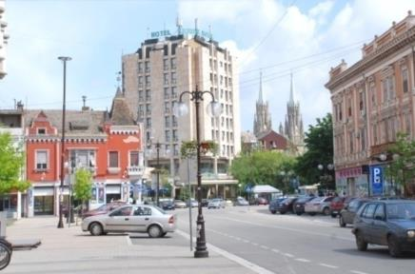
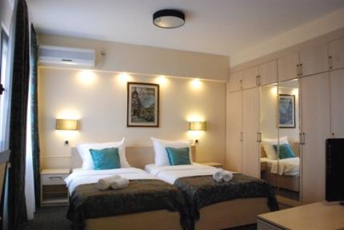
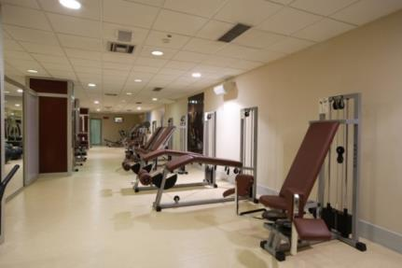
Accommodations
On campus hotel under renovation (project planning phase) to bring it up to the latest standards
Hotel accommodations available at Hotel “Srbija” (3 stars - hotelsrbija.rs) or Villa “Breg” (5 stars - villabreg.com)
Recreational facilities available at the Millenium Sports Center
Medical care available at local health center and Military Medical Academy in Belgrade

Slide 25

Vršac
Located just miles from the Serbian border with Romania and 80km northeast of Belgrade
Town and its inhabitants have welcomed foreign students for decades
Highest levels of student safety and security achieved through a partnership with the local authorities
For more information, visit the town portal:
www.vrsac.com/active/en/home.html

Slide 26
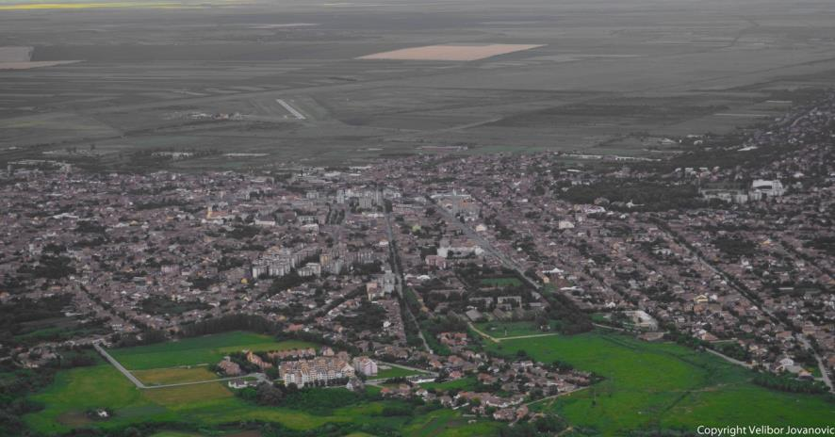
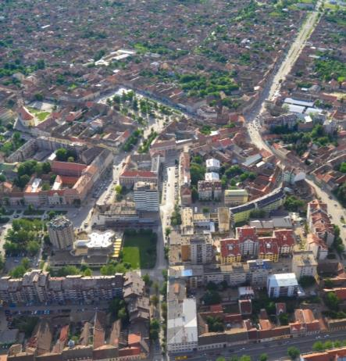

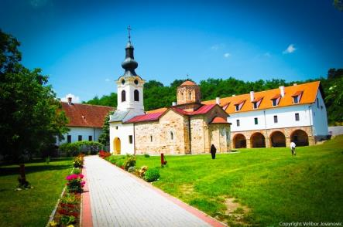

Vršac

Slide 27
Value

Slide 28
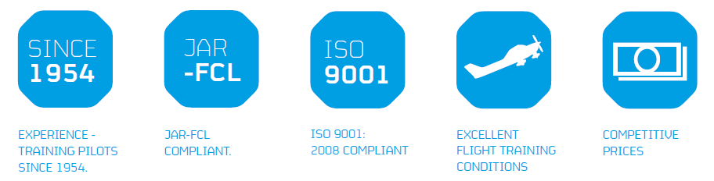
World-wide acceptance
JAR-FCL compliant
Our licenses can be used anywhere within the EU without additional training
We have extensive experience in showing compliance to regulations

Slide 29
Tailored to your needs
Our experience and know-how enable us to tailor student training to your needs:
  Specific operational procedures in accordance with your company’s standards
  CRM and MCC training suited to your company culture
  Possible modification of course duration according to your needs

Slide 30
Conclusion

Slide 31
What sets SAA apart?
Reputation
    We have trained more than 2100 pilots since 1954 that have flown with over 200 different airlines
Capability
    We have our own airport with an air traffic control tower, 1700 square kilometers of dedicated airspace and an updated fleet of 20 airplanes (Cessna 172S, Cessna 172N and Cessna 310)
Value
    We prepare students to become the best pilots they can be and obtain a pilot license at a very competitive price

Slide 32
Contact
SMATSA Aviation Academy
Podvršanska 146
26300 Vršac
Serbia
Tel: +381 11 321 80 20
Fax: +381 11 324 04 56
E-mail: aviationacademy@smatsa.rs
Web: www.saa.rs

